Slide 1

RensselaerList Final Presentation
Team 13 - The Stealth Dragons
Aaryaman Thuloj, Cian Howel, Sam Leung

Slide 2
Today’s schedule
01.
02.
03.
04.
Our Goal
The Team
Our Tech
Value
05.
06.
07.
08.
Our Progress
Demo
Future Plans
Thank You
What we set out to do.
Our developers!
What we used to implement our app.
User and stakeholder value.
What we’ve done since last time
Our application in action!
What would we do in the future?
We hope you enjoyed our presentation!

Slide 3
01.
Our Goal
We wanted to create a platform where RPI students can sell items safely and easily.

Slide 4
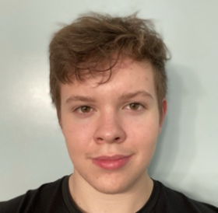
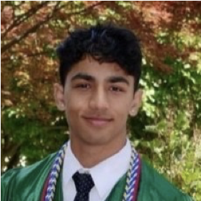
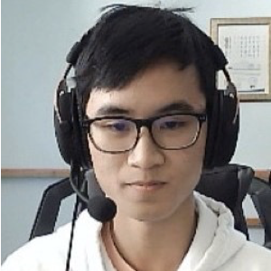
02. Meet Our Team
Cian Howell
Aaryaman Thuloj
Samuel Leung

Slide 5






0.3 Our Technology Stack
HTML, CSS, and JavaScript for core website features
Bootstrap's functionalities for layouts, responsiveness, and UI elements.
PHP for backend connections, mainly to an SQL Database of entries
Integration of RPI's login system (CAS)
Of course, GitHub for version control

Slide 6

0.4 Value

Slide 7



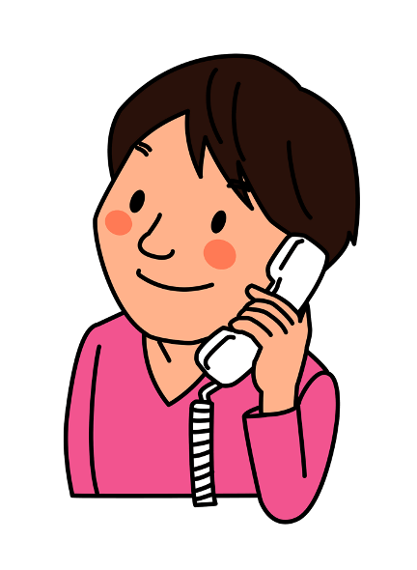

User Value
Target demographic is RPI students.
Takes a lot of risk out of meetups (RPI Auth. Required)
Little to no transportation to buy/sell.
$$$

Slide 8
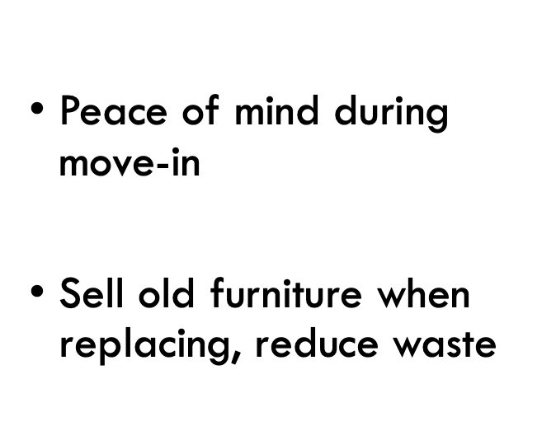

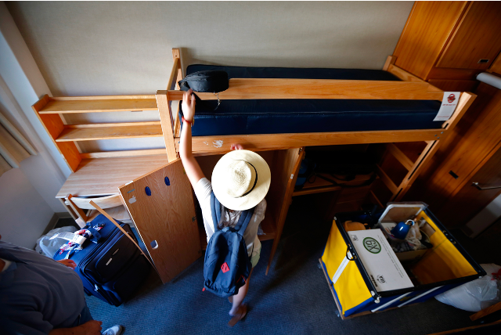
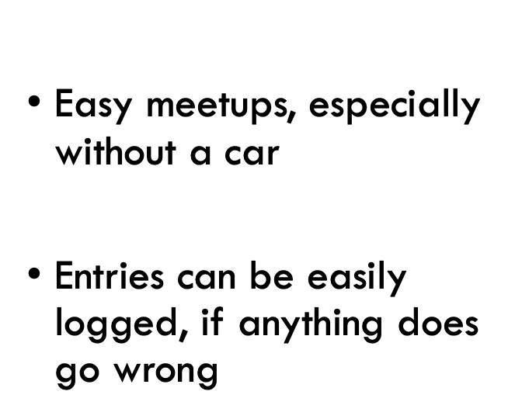
Stakeholder Value

Slide 9
0.5
What we’ve done
The changes we have made can be largely classified into two categories:
Core site functionality (i.e posting, editing, deleting, buying, offering, etc)
Administrative functionality (the addition of admin users who moderate the site’s posts, can ban users, and more)
Most of our time was spent finishing out our backend that mimics a complex online marketplace.

Slide 10
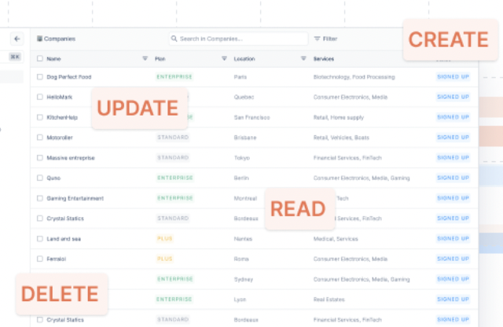
Core Site Functionality
We built our web application to support the CRUD guidelines as follows:
Create - Users can post listings with all the information they want.
Read - Users are able to browse listings and filter them as they please, including their own listings.
Update - Users can edit their own listings and mark items as sold and such.
Delete - Users and administrators can delete listings or remove them from the platform completely.
We also created the guts of an API to use internally, that allows us to have chains of subcategories that further detail listings to choose from when listing an item.
We access this feature using our internalized POST calls, and it is not available externally.

Slide 11
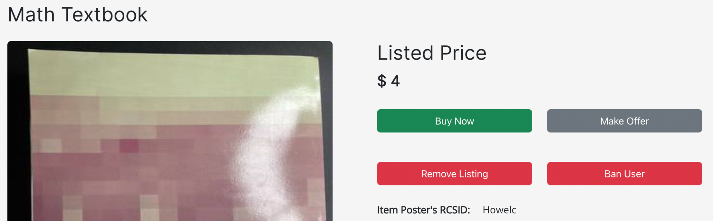
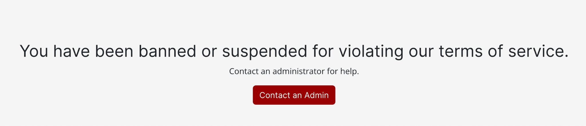
Administrative Measures
Since our app involves making posts online, we implemented administrative accounts that could take action if they see any malicious behavior. This could include spamming ,scamming, inappropriate verbiage, e.t.c.
We did this by making an “admin” role that is able to view all posts, delete any, see the user’s rcsid who posted it, and ban the user if they deem it necessary.
When a user is banned, they see the screen shown on the bottom right:
We also created a Terms of Service.

Slide 12
06.
Project Demo
Click Here!

Slide 13
07.
Future Features
Always looking ahead!

Slide 14

Features to Flesh Out
Create an in-app messaging system for convenience and limited liability.
Payments system that works through the site to ensure fair payments and offer payment protection.
Ability to “request company” from available Public Safety Officers if the user chooses during meetups.
Maybe have designated meetup spots on-campus.
Get money.

Slide 15
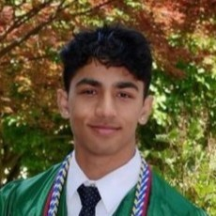

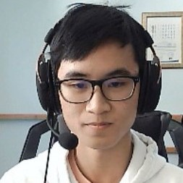
Thank You!
Any Questions?

